Slide 1


Jean monnet module – Doha courses on European union law – Fall 2021
Dr. Ioannis Konstantinidis

Slide 2





Course 2: The EU Charter of Fundamental Rights – Week 6
I. The Accession of the European Union to European Convention on Human Rights
II. The External Action of the European Union and the Question of Human Rights – The Example of Trade Agreements
III. Concluding Remarks

Slide 3

Week 6
Learning Outcomes: On completion of this week, students should
  Have developed an advanced understanding of the relationship between the EU Charter of Fundamental Freedoms and the European Convention on Human Rights
  Have developed an advanced understanding of the the EU External Action and the question of human rights

Slide 4

I. The Accession of the European Union to European Convention on Human Rights
EU Charter vs European Convention on Human Rights Convention - What's the Difference?

Slide 5

I. The Accession of the European Union to European Convention on Human Rights
Background to Accession
  The Lisbon Treaty introduced a new Article, which provides:
    “The Union shall accede to the European Convention for the Protection of Human Rights and Fundamental Freedoms. Such accession shall not affect the Union’s competences as defined in the Treaties.”

Slide 6

I. The Accession of the European Union to European Convention on Human Rights
Background to Accession
  Negotiations for accession started in June 2010 and are ongoing

Slide 7
I. The Accession of the European Union to European Convention on Human Rights
Background to Accession
  The European Convention of Human Rights (ECHR) is a charter of rights adopted in the aftermath of the Second World War by the Council of Europe, a body distinct from, and of much wider composition than, the EU
  In order to ensure that the Convention would have ‘teeth’, the contracting parties set up an international court, the European Court of Human Rights (ECtHR) entrusted with interpreting the ECHR and holding the contracting parties to account
  Cases before the ECtHR can be brought by individual parties
  Individuals must have exhausted domestic remedies before being able to bring a case before the ECtHR

Slide 8
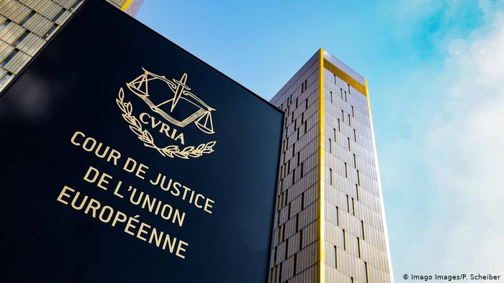
I. The Accession of the European Union to European Convention on Human Rights
Background to Accession
  From the very first cases concerning human rights protection in the (then) EEC, the European Court of Justice stated that it would draw inspiration also from the ECHR, and that this document had special importance for the EU
  Furthermore, in interpreting fundamental rights, the European Court of Justice looks at the jurisprudence of the ECtHR and whilst discrepancies in the interpretation given by the two courts have occurred, those have not been intentional

Slide 9
I. The Accession of the European Union to European Convention on Human Rights
Background to Accession
  The ECHR is already part of EU public law: it is mentioned in the Treaties and it is applied through the case law of the European Court of Justice
  However, the fact that the EU is not a party to the ECHR raises very serious legal and political issues

Slide 10

I. The Accession of the European Union to European Convention on Human Rights
Background to Accession
  It excludes the jurisdiction of the ECtHR over the EU; and
  Respect for human rights is a precondition for joining the EU and yet the EU does not subject itself to any external scrutiny of its fundamental rights compliance

Slide 11
I. The Accession of the European Union to European Convention on Human Rights
EU’s Accession
  In 1996, the European Court of Justice gave its first opinion on the EU’s accession to the ECHR (Opinion 2/94). At the time, the court ruled that the European Community did not have the competence to accede to the ECHR (paras 34-35)
  A legal basis for the accession was established when the Lisbon Treaty entered into force in 2009. Article 6(2) states that the EU shall accede to the ECHR and hence, creates a legal obligation

Slide 12
I. The Accession of the European Union to European Convention on Human Rights
EU’s Accession
  The 14th Protocol to the ECHR paved the way for the accession by introduction of Article 59(2) ECHR declaring that the EU may accede to the ECHR
  In 2013, the draft Accession Agreement was submitted to the European Court of Justice to obtain an opinion on the compatibility with the treaties

Slide 13
I. The Accession of the European Union to European Convention on Human Rights
EU’s Accession
  In the following year, the court delivered the famous Opinion 2/13 and despite significant arguments in favor of an accession, concluded that the draft Accession Agreement was incompatible with EU law (para 258): EU’s special characteristics, co-respondent system, inter-State cases etc.
  Interestingly, the European Commission, supported by observing Member States (para 109), advocated the opposite position (para 73)

Slide 14
I. The Accession of the European Union to European Convention on Human Rights
EU’s Accession
  In late 2019, the EU and the Council of Europe announced their willingness to proceed with the negotiations on the EU’s accession

Slide 15
I. The Accession of the European Union to European Convention on Human Rights
EU’s Accession – A Work in Progress
  Will the revised Accession Agreement again be subject of an opinion by the European Court of Justice?
  The ECtHR could also be asked to give its opinion on the agreement

Slide 16

II. The External Action of the European Union and the Question of Human Rights

Slide 17

II. The External Action of the European Union and the Question of Human Rights
Human Rights in the EU’s Bilateral and Regional Trade Agreements
  To date, the EU has concluded and is in the process of negotiating an array of international trade agreements
  Since the 1990s, it has been a policy of the EU that all framework agreements concluded with third countries – such as Association Agreements, Partnership Agreements and Cooperation Agreements – should include a ‘human rights’ clause

Slide 18

II. The External Action of the European Union and the Question of Human Rights
Human Rights in the EU’s Bilateral and Regional Trade Agreements
  These agreements provides that the respect for human rights, democracy and the rule of law constitutes the basis for the agreement and represents the ‘essential element’ of the agreement on which the reciprocal obligations of the parties are premised, so that human rights violations of a certain scale by one of them can amount to a material breach of the agreement and justify suspension or other countermeasures

Slide 19

II. The External Action of the European Union and the Question of Human Rights
Human Rights in the EU’s Bilateral and Regional Trade Agreements
  There are clear patterns in the drafting of the essential elements clause
  These clauses have evolved over the years and can be grouped by country and/or regional bloc

Slide 20
II. The External Action of the European Union and the Question of Human Rights
Human Rights in the EU’s Bilateral and Regional Trade Agreements
  There is also a ‘non-execution’ clause stating that in the event that one party fails to comply with its obligations, the other party is able to adopt ‘appropriate measures’
  According to the Commission, sanctions under the clause should be reserved only for the most extreme and flagrant violations of human rights

Slide 21
II. The External Action of the European Union and the Question of Human Rights
Human Rights in the EU’s Bilateral and Regional Trade Agreements
  Example, the EU – Colombia and Peru Trade Agreement: “‘any Party may immediately adopt appropriate measures in accordance with international law in case of violation by another Party of the essential elements referred to in Articles 1 and 2 of this Agreement”

Slide 22
II. The External Action of the European Union and the Question of Human Rights
Human Rights in the EU’s in the New Generation of Association Agreements (AA)
  Examples: Agreements with Ukraine, Georgia and Moldova (2014)
  These agreements represent the most extensive form of cooperation offered by the EU to its non-candidate neighbors

Slide 23
II. The External Action of the European Union and the Question of Human Rights
Human Rights in the EU’s in the New Generation of Association Agreements (AA)
  The human rights clauses included in these agreements are conceived differently in comparison with the human rights clauses included in simple trade agreements due to the legal and political specificities of these countries
  Out of the three agreements the EU-Ukraine AA stands out not only for its comprehensiveness and complexity but particularly for its strict conditionality

Slide 24
II. The External Action of the European Union and the Question of Human Rights
Human Rights in the EU’s in the New Generation of Association Agreements (AA)
  An extensive list of international instruments constitutes the basis for the essential elements that the parties must respect in their domestic and foreign policies
  In addition to the Universal Declaration of Human Rights, the essential elements clauses make references to the European Convention on Human Rights and other human rights related instruments
  Moreover, the essential elements clauses in all three AAs require the respect of human rights by the contracting parties both in their domestic and external policies

Slide 25

III. Concluding Remarks
  Despite the complexities, there is no doubt that the EU accession to the ECHR will be a positive step and will ensure that the EU is bound by the same rules that bind its Member States and its international partners
  EU’s practice of linking economic benefits to human rights conditionality is clearly the standard modus operandi of the EU. Is its effectiveness uniform ?

Slide 26
Questions?

