Slide 1


Jean monnet module – Doha courses on European union law – Spring 2021
Dr. IOANNIS KONSTANTINIDIS

Slide 2






WELCOME TO THE COURSE
Instructor
Dr. Ioannis Konstantinidis, Assistant Professor, College of Law, Qatar University
Ph.D. – Sorbonne Law School/Université Paris 1 Panthéon-Sorbonne, France
LL.M. – Sorbonne Law School/Université Paris 1 Panthéon-Sorbonne, France
M.A. – Institut d’Etudes Politiques de Paris/Sciences Po, France
B.A. – National and Kapodistrian University of Athens, Greece

Slide 3

WELCOME TO THE COURSE
Contact Details
Email: ikonstantinidis@qu.edu.qa
Office: New Faculty Building I03, Office 618
Office Hours (via Blackboard Collaborate): Monday, 10:00AM – 11:00 PM

Slide 4

WELCOME TO THE COURSE
Course Information
Class Days: Sunday/Tuesday/Thursday
Class Time: 4:00 PM – 5:00 PM
Classes will be held online via WEBEX

Slide 5

Students
Students
  What is your background?
  Why did you choose this course?
  What are your expectations for this course?

Slide 6
students
Students
  European Union: What is the first thing that comes to mind?

Slide 7
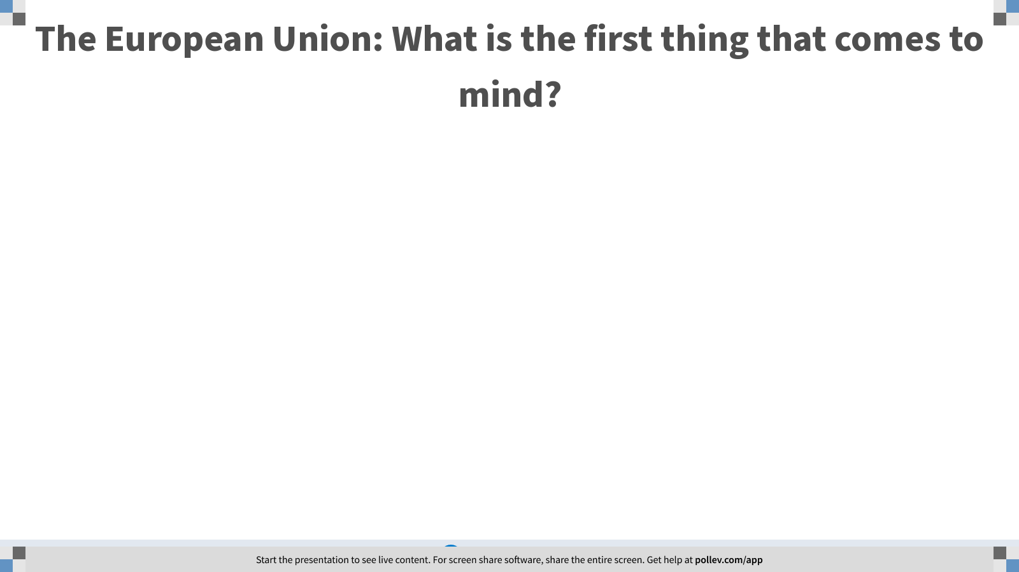
Notes:
Poll Title: The European Union: What is the first thing that comes to mind?
https://www.polleverywhere.com/free_text_polls/twTQjGgyX4xqanyVQN1Wt

Slide 8
Course 1: The European Union: Legal History and Institutions – Week 4
I. Introduction to the Institutions of the European Union
II. The European Council, the Commission and the Council
III. Concluding Remarks

Slide 9

Week 1
Learning Outcomes: On completion of this week, students should
  Have developed an advanced understanding of the functions, composition and working procedures of the European Council, the Commission and the Council

Slide 10

I. Introduction to the Institutions of the European Unions
How does the European Union (EU) work?

Slide 11
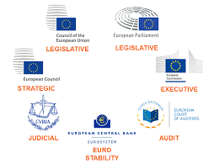
I. Introduction to the Institutions of the European Unions
EU Institutions
  The EU shall have an institutional framework which shall aim to promote its values, advance its objectives, serve its interests, those of its citizens and those of the Member States, and ensure the consistency, effectiveness and continuity of its policies and actions

Slide 12
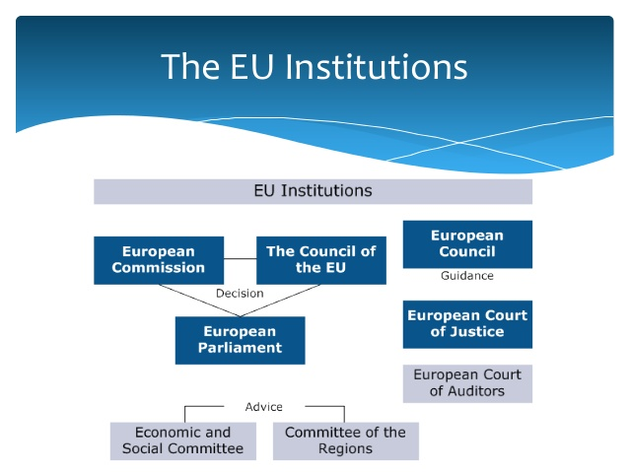
I. Introduction to the Institutions of the European Unions
EU Institutions pursuant to article 13(1) of the Treaty on European Union (TEU)
  The European Parliament
  The European Council
  The Council
  The European Commission
  The Court of Justice of the European Union
  The European Central Bank
  The Court of Auditors

Slide 13

I. Introduction to the Institutions of the European Unions
The European Council
  The European Council was created as an informal forum following a meeting of the heads of State and government in Paris in 1974
  It received recognition in the Single European Act in 1987, was granted a formal status in 1992 and was finally recognized as an official Union institution in the Treaty of Lisbon in 2009
  Attention: The European Council should not be confused with the Council of the European Union (the Council) or the Council of Europe, which is not an EU organization

Slide 14
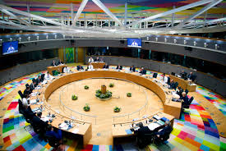
I. Introduction to the Institutions of the European Unions
The Functions of the European Council
  The European Council is essentially a political forum in which the Member States’ heads of state or government, together with its President and the President of the Commission, determine the political agenda for the Union
  It is also at European Council meetings that discussions will take place on matters relating to the common foreign and security policy and other areas of the Union’s external action

Slide 15
I. Introduction to the Institutions of the European Unions
The Functions of the European Council
  The subject matter of European Council meetings depends on a number of different factors
  Examples: on 29 April 2017, a Special European Council was held to establish the Union’s position regarding the UK’s decision to withdraw from the Union

Slide 16
I. Introduction to the Institutions of the European Unions
The Functions of the European Council
  The European Council plays an important role in certain appointment procedures for high profile EU level roles. In particular, it is responsible for:
    electing the President of the European Council
    proposing the President of the European Commission
    appointing the High Representative of the Union for Foreign Affairs and Security Policy
    officially appointing the entire body of Commissioners
    appointing the Executive Board of the European Central Bank (ECB), including the ECB president

Slide 17

I. Introduction to the Institutions of the European Unions
The European Commission
  The role of the Commission is set out in Article 17(1) TEU
  “The Commission shall promote the general interest of the Union and take appropriate initiatives to that end. It shall ensure the application of the Treaties, and measures adopted by the institutions pursuant to them. It shall oversee the application of Union law under the control of the Court of Justice of the European Union…”

Slide 18
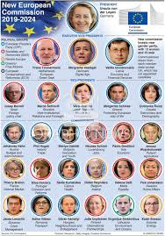
I. Introduction to the Institutions of the European Unions
The European Commission - Function
  to act as the executive of the Union and to see that Union policy is carried out
  To formulate new policy and to draft legislation to give it effect
  To police observance of Union rules
  To a lesser extent, to act as a legislative body in its own right. This latter function is largely related to the making (and enforcement) of detailed rules for the implementation of the Common Agricultural Policy.

Slide 19
I. Introduction to the Institutions of the European Unions
The European Commission

Slide 20
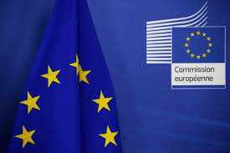
I. Introduction to the Institutions of the European Unions
The European Commission – Functions – Initiation of new legislation and policies
  Article 17(2) TEU explicitly states that: “Union legislative acts may only be adopted on the basis of a Commission proposal, except where the Treaties provide otherwise. Other acts shall be adopted on the basis of a Com-mission proposal where the Treaties so provide”
  Although the Commission is often described as the Union’s executive, that description does not do justice to its major policy-making role

Slide 21
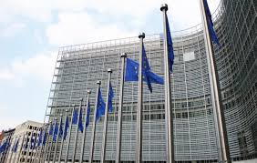
I. Introduction to the Institutions of the European Unions
The European Commission – Functions – “Guardian of the Treaties”
  Keeper of the “soul” of the Union, maintaining its course towards its declared aims of political and economic unity,
  Role of ensuring that EU law is effectively implemented and obeyed. This role is discharged both through political contact and, if need be, by the initiation of proceedings against Member States

Slide 22
I. Introduction to the Institutions of the European Unions
The European Commission – Functions – Allocation of EU funding
  Every year, the Commission submits a draft EU budget
  The draft is then subject to amendment by both the Council and the European Parliament before it is agreed

Slide 23
I. Introduction to the Institutions of the European Unions
The European Commission – Functions – International representation
  The Commission also has an important external role, representing the Union in negotiations with other groups of States and trading organizations
  It shall be responsible for ensuring that the agreements negotiated are compatible with the internal Union policies and rules.

Slide 24
I. Introduction to the Institutions of the European Unions
The European Commission – Composition
  The European Council proposes to the European Parliament a candidate for President of the Commission
  The President is elected by the European Parliament by a majority of its component members. If this majority is not forthcoming, then the European Council shall within one month propose a new candidate who shall be elected by the European Parliament following the same procedure

Slide 25
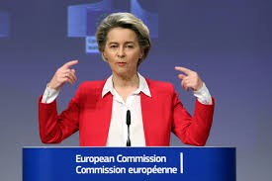
I. Introduction to the Institutions of the European Unions
The European Commission – Composition
  The President is then involved in the appointment of the individual Commissioners
  The potential Commissioners who are proposed by the Council and the President of the Com-mission are first suggested to them by the Member States
  Article 17(7) TEU then provides that the President, the High Representative and the other members of the Commission shall be subject as a body to a vote of consent by the European Parliament

Slide 26

I. Introduction to the Institutions of the European Unions
The Council
  The Treaties now refer to the Council, but some commentators still refer to the Council of Ministers, as it was previously known, due to its being composed of Member State politicians

Slide 27
I. Introduction to the Institutions of the European Unions
The Council

Slide 28

I. Introduction to the Institutions of the European Unions
The Council – Functions
  The function of the Council is set out in Article 16(1) TEU in very broad terms: “The Council shall, jointly with the European Parliament, exercise legislative and budgetary functions. It shall carry out policy-making and coordinating functions as laid down in the Treaties”
  Decision-making remains the central role of the Council
  While the Commission promotes the interests of the Union, the Council primarily represents the national interests of the Member States

Slide 29
I. Introduction to the Institutions of the European Unions
The Council – Composition
  The Council consists of a representative of each Member State at ministerial level “who may commit the government of the Member State in question and cast its vote’ (Art 16(2) TEU)”
  The Council is therefore made up of politicians from the Member States who are authorized to bind the Member State they represent.

Slide 30
I. Introduction to the Institutions of the European Unions
The Council – Composition
  There are no fixed members of the Council and membership will vary according to the matter under discussion
  Article 16(6) TEU provides for the Council to meet in different configurations. These configurations are determined by the European Council

Slide 31
I. Introduction to the Institutions of the European Unions
The Council – Composition
  The office of President of the Council is held in turn by each Member State for a period of six months in the order decided by the Council acting unanimously.

Slide 32

I. Introduction to the Institutions of the European Unions
The Council – COREPER
  COREPER, which is the French acronym for the Committee of Permanent Representatives, plays an important role in providing continuity during the inevitable absences of relevant ministers from the Council
  The Committee consists of senior national officials who are permanently located in Brussels

Slide 33

I. Introduction to the Institutions of the European Unions
The High Representative of the Union for Foreign Affairs and Security Policy
  Article 18 TEU provides for the appointment of the High Representative of the Union for Foreign Affairs and Security Policy
  Although clearly not one of the EU institutions, this is an appropriate point to consider the High Representative

Slide 34
I. Introduction to the Institutions of the European Unions
The High Representative of the Union for Foreign Affairs and Security Policy – Role
  The High Representative is appointed by the European Council with the agreement of the President of the Commission
  Conducts the Union’s common foreign and security policy
  Chairs the Foreign Affairs Council
  Serves as one of the Vice-Presidents of the Commission

Slide 35
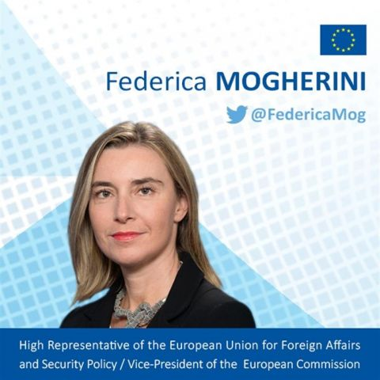
I. Introduction to the Institutions of the European Unions
The High Representative of the Union for Foreign Affairs and Security Policy – Role
  Two-hatted role
  Consistency of the Union’s external action as a whole

Slide 36
Next Week: The European Parliament, the court of justice of the European union – Special focus on the eu legislative process
  ­Readings
  Per the course syllabus

Slide 37
Questions?

