Slide 1
SESRI Workshop on Survey-based Experiments
Session 8: Implementing Survey Experiments
April 19, 2017
Doha, Qatar

Slide 2
Outline of Session 8: What You Will Learn
Tradeoffs in the conduct of survey experiments
Alternative platforms for conducting survey experiments
Choosing the best platform for your work

Slide 3
Implementing Survey Experiments
The primary considerations
How many subjects/respondents do I need?
How important is time to field?
How big is my budget?
Concerns about external validity?

Slide 4
Implementing Survey Experiments
Sorting out the number of subjects:
Power analysis based on current knowledge of expected effects and outline of the experiments (# treatments)
Point estimate (i.e., mean or proportion) and its variance
Desired level of precision in the estimate
Desired confidence in incorrectly rejecting the null H
Valiant, Dever, & Kreuter, “Power Calculations and Sample Size Determination”

Slide 5
Implementing Survey Experiments
The low cost option: Amazon Mechanical Turk (MTurk)
Advantages | Disadvantages
Low cost | Nonprobability sample
Speedy data collection | Sample biases

Slide 6
Implementing Survey Experiments
The low cost option: Amazon Mechanical Turk (MTurk)
Mode: online web surveys
Recruitment: Volunteer, non probability panel
Sample Specs: Can be specified
Questionnaire: Qualtrics instrument or TurkSuite Template Generator (http://mturk.mit.edu/template.php)
Special terminology: Requesters and Workers perform Human Intelligence Tasks (HITs)
Developing applications: http://mturk.mit.edu/tutorial/1.php
Fees: Payment to Workers per survey, overhead to MTurk

Slide 7
Implementing Survey Experiments
Another low cost option: Qualtrics (https://www.qualtrics.com/)
Mode: online web surveys
Recruitment: Purchased samples from different suppliers
Sample Specs: Can be specified, with quotas, from a supplier
Questionnaire: Proprietary software that can export an SPSS dataset , .CSV file, and other fixed field formats
Template Generator: (https://www.qualtrics.com/research-core/)
Fees: Cost per completed interview, work with salesperson. Many educational institutions have group licenses

Slide 8
Implementing Survey Experiments
Other low cost options: SurveyMonkey
Mode: online web surveys
Recruitment: anyone who answers a SurveyMonkey survey
Sample specs: can be specified, with quotas, from their panel
Questionnaire: Proprietary software with applications accepted by many firms. No exporting data
Fees: Subscription by month or year with educational discount

Slide 9
Implementing Survey Experiments
Time-Sharing Experiments in the Social Sciences: TESS
Have to prepare a proposal for peer review
Wait for an appropriate field period
Some decisions made by TESS staff
Have to wait for field period for omnibus survey
http://www.tessexperiments.org/

Slide 10
Implementing Survey Experiments
Other low cost options: TESS
Mode: online web surveys
Recruitment: through NORC’s AmeriSpeak panel
Sample specs: probability-based sample with Internet access provided to those who need it; sample sizes negotiated with TESS staff
Questionnaire: Prepared by TESS staff according to specs supplied by researcher
Fees: Free with support from NSF; data made publicly available one year after data collection
(http://www.tessexperiments.org/faqindex.html)

Slide 11
Implementing Survey Experiments
Other available national panels with probability samples, modeled after TESS:
Longitudinal Internet Studies for the Social Sciences (Netherlands) https://www.lissdata.nl/lissdata/
GESIS - Leibniz Institute for the Social Sciences at the University of Mannheim http://www.gesis-panel.org/
Another American alternative: Gfk Knowledge Panel
http://www.knowledgenetworks.com/ganp/probability.html
Notes:
LISS is web only
GESIS is mixed mode - phone or web

Slide 12
Implementing Survey Experiments
Possibilities for mixed platform studies: Carbon Recapture Study
Design features: knowledge, attitudes & beliefs, support for policies
How to build knowledge and attitude scales?
Notes:
LISS is web only
GESIS is mixed mode - phone or web

Slide 13
Implementing Survey Experiments: Example
MTurk for item assessment in Pretest 1
Mturk for development of final instrument in Pretest 2
Gfk KnowledgePanel for final study
Notes:
LISS is web only
GESIS is mixed mode - phone or web

Slide 14
Implementing Survey Experiments: Example
MTurk for item assessment in Pretest 1
Mturk for development of final instrument in Pretest 2
Gfk KnowledgePanel for final study
Notes:
LISS is web only
GESIS is mixed mode - phone or web

Slide 15
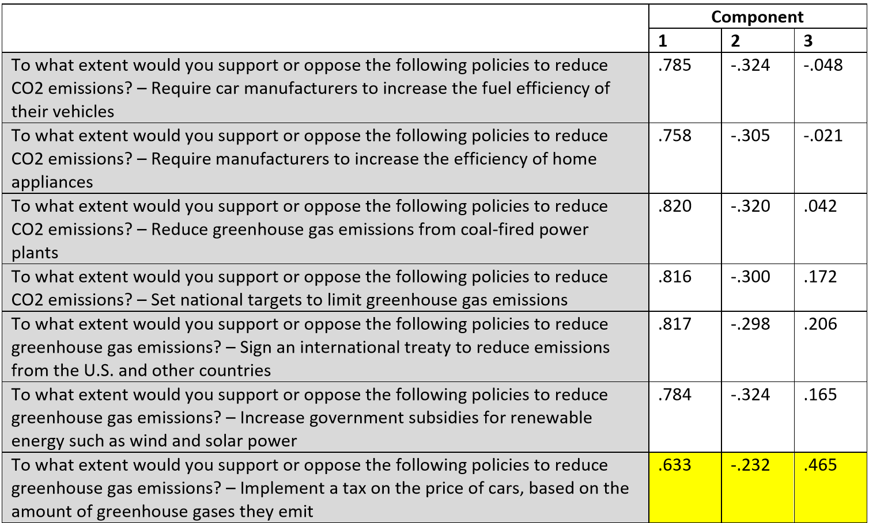
Implementing Survey Experiments: Example

Slide 16
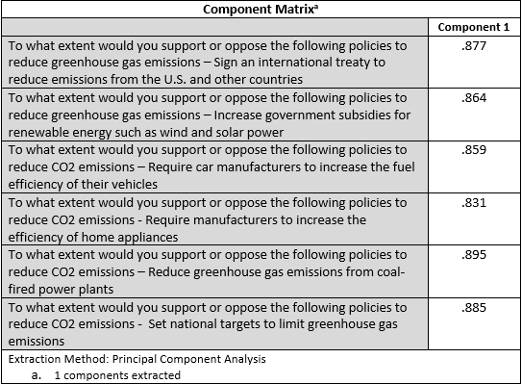
Implementing Survey Experiments: Example
Single factor solution
Notes:
LISS is web only
GESIS is mixed mode - phone or web

Slide 17
Clicker Question 13
Which of the following is not a consequence of using MTurk?
Highly educated respondents
Representative sample
Inexpensive
Rapid data collection

Slide 18
Clicker Question 14
Which of the following is a disadvantage of using TESS?
Peer review of proposals
Representative sample
Inexpensive
Order effects

